Slide 1
POLS 207 State & Local Government*
Chapter 11B
Adjudicating the Law: Policy and the Courts (Part 2)
Dr. Roblyer, Ph.D.
*These slides are based on originals provided by Dr. Harvey Tucker

Slide 2
Learning Objectives
Describe or draw out the diagram that shows all of the types and subtypes of courts in Texas. Include the flows of appeals from all of the lower courts.
In general terms, differentiate between the roles and the jurisdictions of each of these courts. (Use the lecture as your guide as to level I’m expecting.)
Describe how state residents participate in the judicial system and how they are selected.
Explain the issues with fairness and peremptory strikes in jury trials. Discuss whether this is a partisan issue.
Discuss the qualifications of attorneys and judges/justices in Texas.
Compare and contrast the systems that US states use to select their judges/justices. Explain why there may be differences within a given state as to the selection method for trial courts and for appellate courts.
Describe the “Choose Well” video, including its strengths and weaknesses.

Slide 3

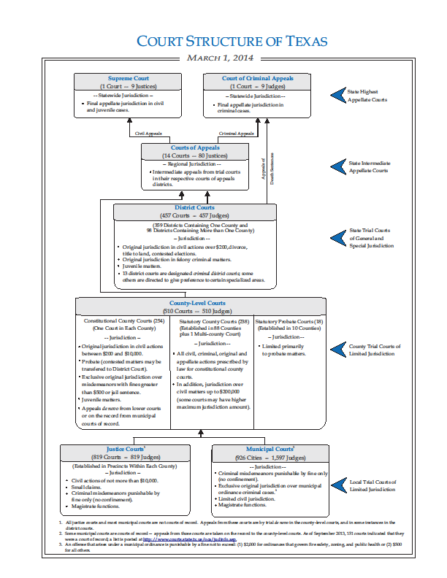
Appellate
jurisdiction
Second Slide
Original
jurisdiction
(YOUR case
enters here)
Next Slide
http://openclipart.org/detail/5490/magnifying-glass-by-mcol
http://www.courts.state.tx.us/

Slide 4
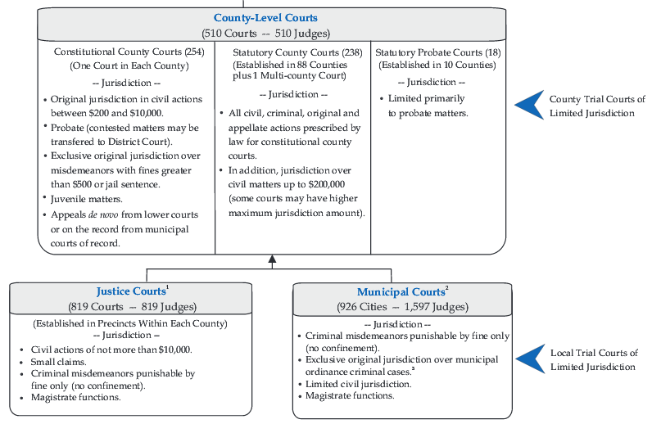
Appeals go to Court of Appeals

Slide 5
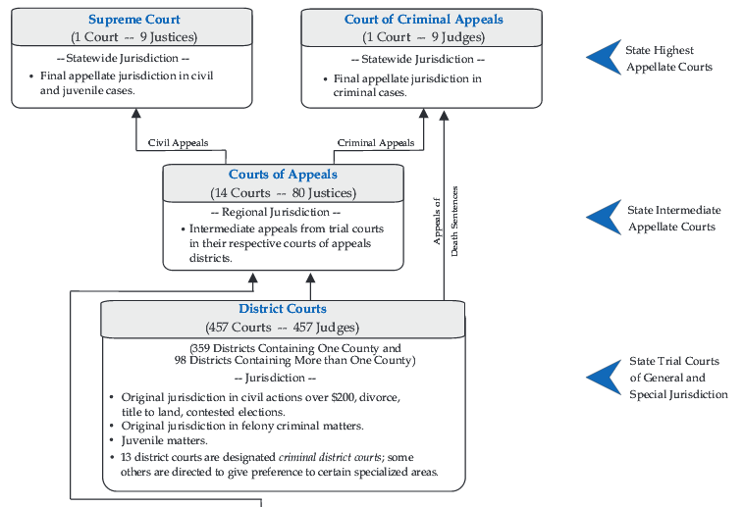
Separate courts of final appeal
Appeals coming in from County Courts

Slide 6
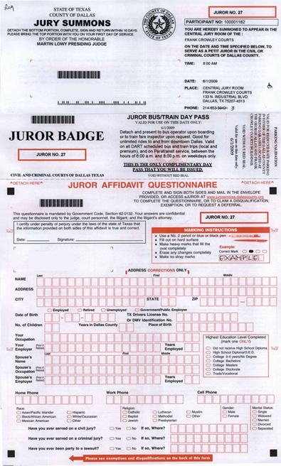

Slide 7
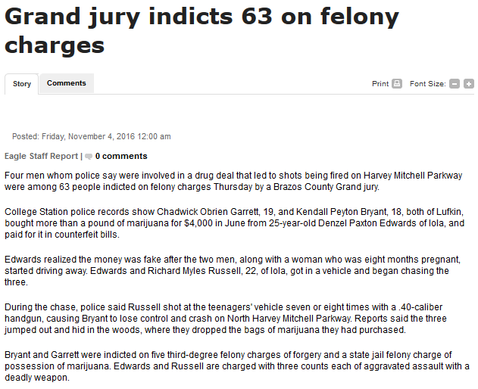
Lay Participation in the State System
Grand juries
Decide whether or not to indict [in-dite’ ] accused individual and send them to trial
Grand jury of community members reviews state’s evidence: Does it justify putting the charged person on trial?
In Texas: 12 members with term of 3-6 months
Members must be able to commit 2 long days each month to reviewing 50-75 cases each day
How is this grand jury selected?
Old way: “Key Man” or “Pick-a-Pal”
New way: “Random selection”
…What does this say about likely membership?
http://www.theeagle.com/news/local/grand-jury-indicts-on-felony-charges/article_dc7328c3-356b-5e94-b510-20b20ca83e82.html

Slide 8
Lay Participation in the State System
“Key Man” was the method used in Texas through August 2015 to select grand juries
Grand jurors were selected by “jury commissioners” picked by the district judge
This is why the system was also known as “Pick-a-Pal”
System was often accused of being a “rubber stamp” that approved whatever prosecutions the District Attorney (DA) wanted
Grand juries rarely decided to “no bill” (set free before trial) an accused individual
System was also accused of persistent economic bias
Most indicted individuals were from lower income brackets
Grand jurors were often of above-average wealth—could afford taking time off to serve

Slide 9
Lay Participation in the State System
“Random Selection” is new process for Grand Jury selections (as of Sep 2015)
Approved by Texas legislature, governor
Makes system function similarly to how trial juries are selected in order to “better represent the community”
“Helps address possible biases” in old approach
Time will tell: Improved representation? Less biased?

Slide 10
Lay Participation in the State System
Trial juries
12-person jury in District Courts
6-person juries in County and Justice-of-the-Peace Courts
Qualifications to serve:
Over 18yo and eligible to vote
Not under felony indictment
Registering to vote usually adds you to pool of potential jurors
If “summoned,” full-time students may claim an exemption—never just ignore a jury summons!
“Jury of peers” usually over-represents professionals, managers, small business owners (not a problem if you are from one or more of those groups…)

Slide 11
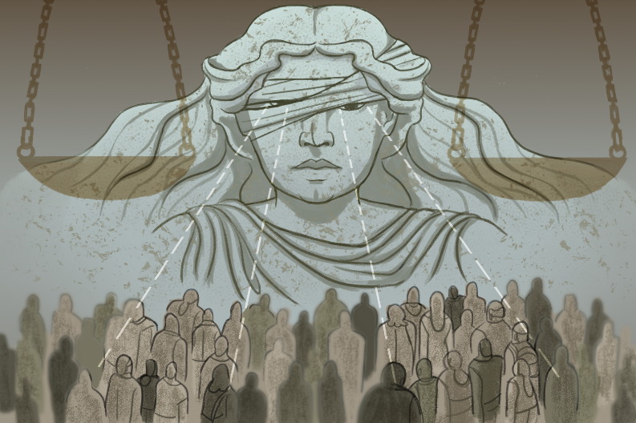
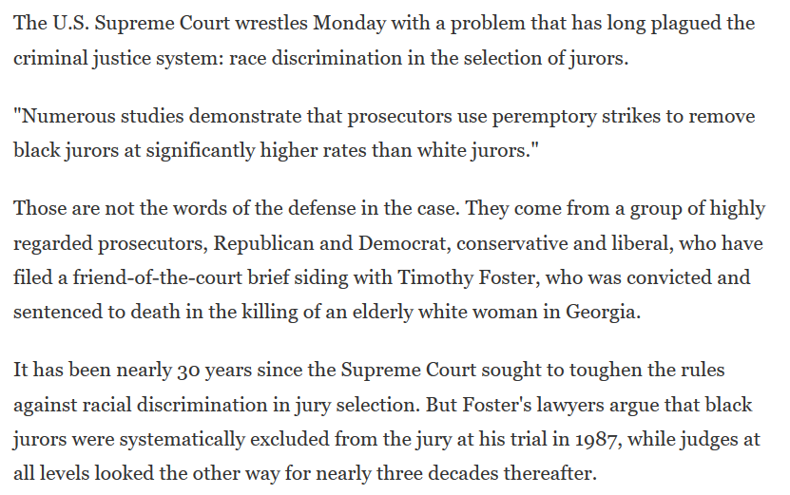
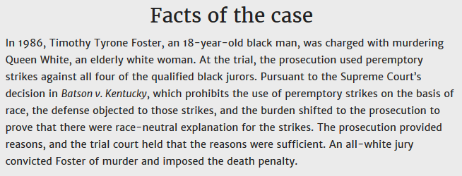
Is jury selection color blind?
U.S. Supreme Court decided in 2016 that jury selection process was biased in a single case
Not the broad decision for which many had hoped
Selection process has not been revised for over 30 years
Foster v. Chatman
https://www.oyez.org/cases/2015/14-8349
http://www.npr.org/2015/11/02/452898470/supreme-court-takes-on-racial-discrimination-in-jury-selection

Slide 12
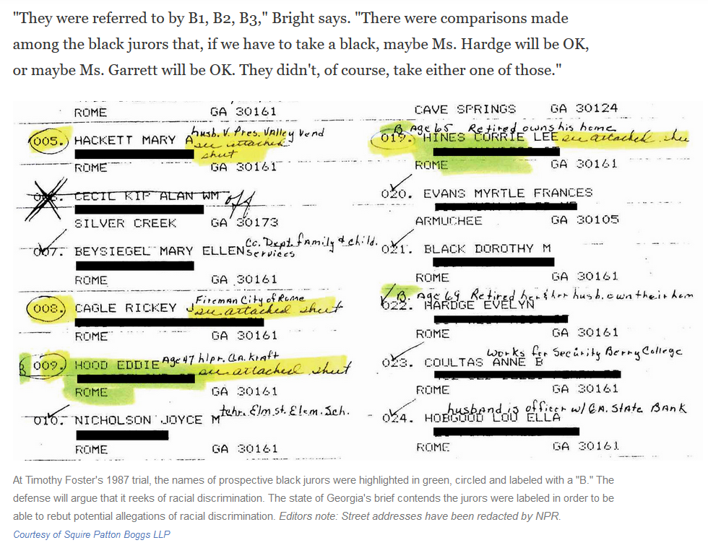
Is jury selection color blind?
U.S. Supreme Court decided in 2016 that jury selection process was biased in a single case
Not the broad decision for which many had hoped
Selection process has not been revised for over 30 years
Foster v. Chatman
https://www.oyez.org/cases/2015/14-8349
http://www.npr.org/2015/11/02/452898470/supreme-court-takes-on-racial-discrimination-in-jury-selection

Slide 13
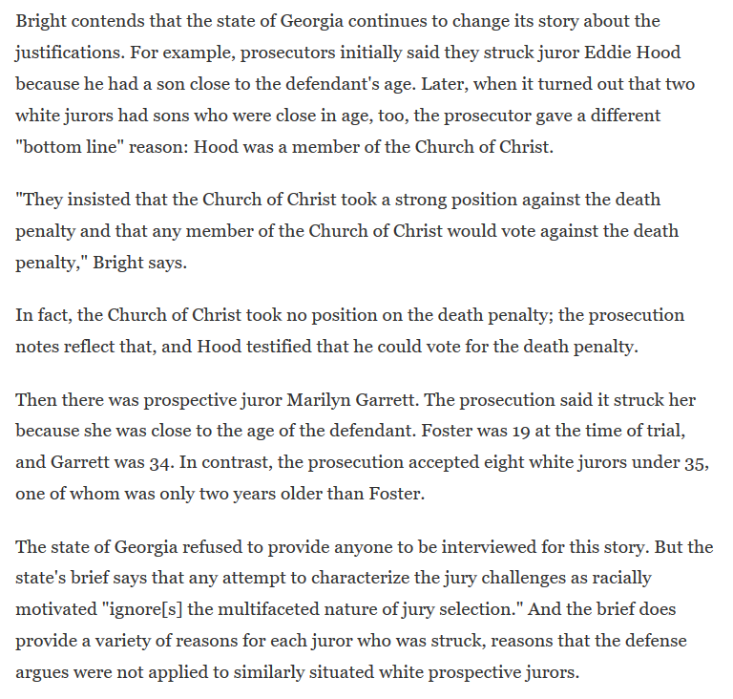
Is jury selection color blind?
U.S. Supreme Court decided in 2016 that jury selection process was biased in a single case
Not the broad decision for which many had hoped
Selection process has not been revised for over 30 years
Foster v. Chatman
https://www.oyez.org/cases/2015/14-8349
http://www.npr.org/2015/11/02/452898470/supreme-court-takes-on-racial-discrimination-in-jury-selection

Slide 14
Elite Participation (“Elite” = Educated, wealthy, not representative of communities’ sex, race, ethnicity)
Attorneys
Law degree mandatory – very expensive to obtain
Must be licensed by at least one State Bar Association (part interest group, part regulatory group)
Must pass test, meet character requirements for each state in which they will practice
Judges – Many were first attorneys, but not all!
TX qualifications vary widely by level
Municipal – set by each city
Justice of the Peace – no law degree or judicial experience required, but must take a special course if elected; > 18 yo
County & District – >4 yrs as attorney/judge, > 25 years old
Appellate – >10 yrs as attorney/judge, >35 years old

Slide 15
Judicial Selection in the States
TRIAL COURT JUDGES
Legislative election 2
Appointed by governor 2
Partisan election 11
Nonpartisan election 16
Merit plan 19
APPELLATE COURT JUDGES
Legislative election 2
Appointed by governor 3
Partisan election 7
Nonpartisan election 14
Merit plan 24
Why the differences in approach between trial and appellate? More value-setting decisions in appellate courts?
These are hybrids of the appointment and elective approaches in which the judge or justice is first appointed, then must meet one or more “retention” elections. This effectively gives the voters a delayed veto in the appointment process.

Slide 16
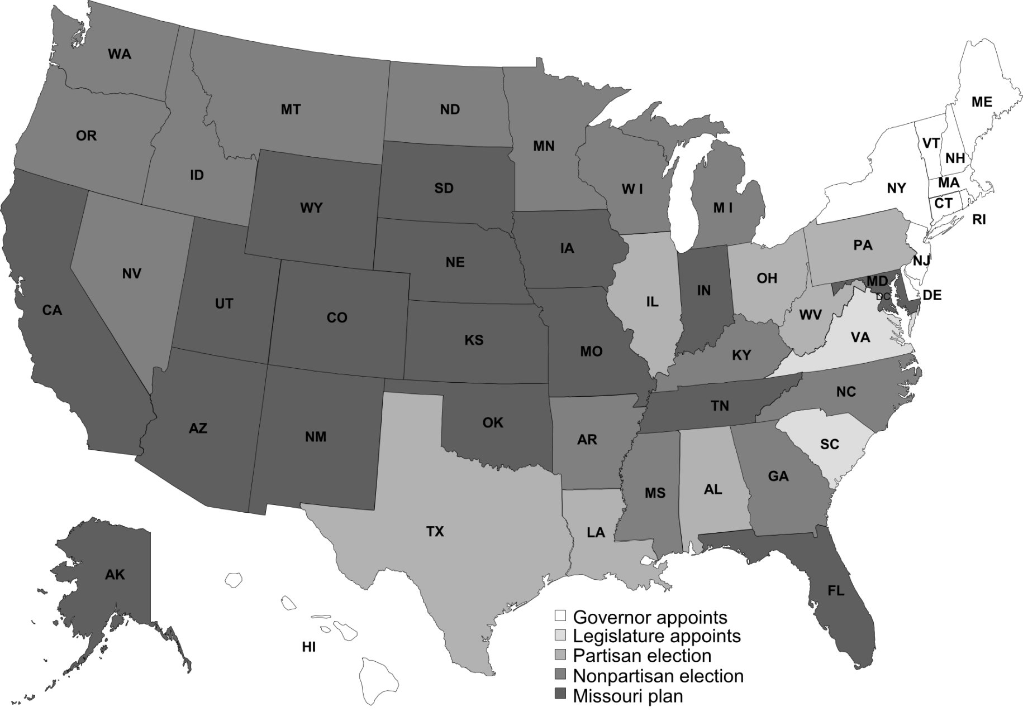
Selection of Justices For State Courts of Last Resort
Do you see regional patterns?
Does Texas have much company?

Slide 17
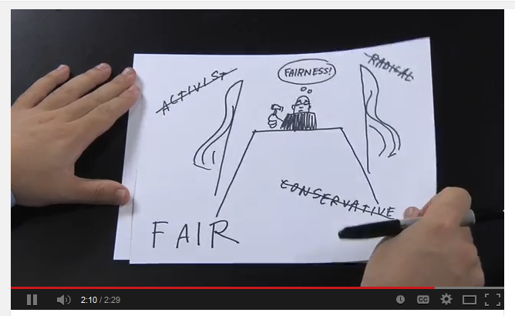
Public Service Announcement or Advertisement with an Agenda?
“Choose Well – Texas Judicial Elections”
http://youtu.be/3_vNwQ-i0fA
Notes:
http://youtu.be/3_vNwQ-i0fA

Slide 18
Public Service Announcement or Advertisement with an Agenda?
“Choose Well – Texas Judicial Elections”
http://youtu.be/3_vNwQ-i0fA
Is “fairness” really the only or best criteria?
How does one measure “fairness” fairly?

Slide 19
Practice Problems …to begin mastering this material. Complete instructions are in the Module 1 resource, How to Use Practice Problems to Prepare for Exams.
Don’t forget to do the…

